Slide 1
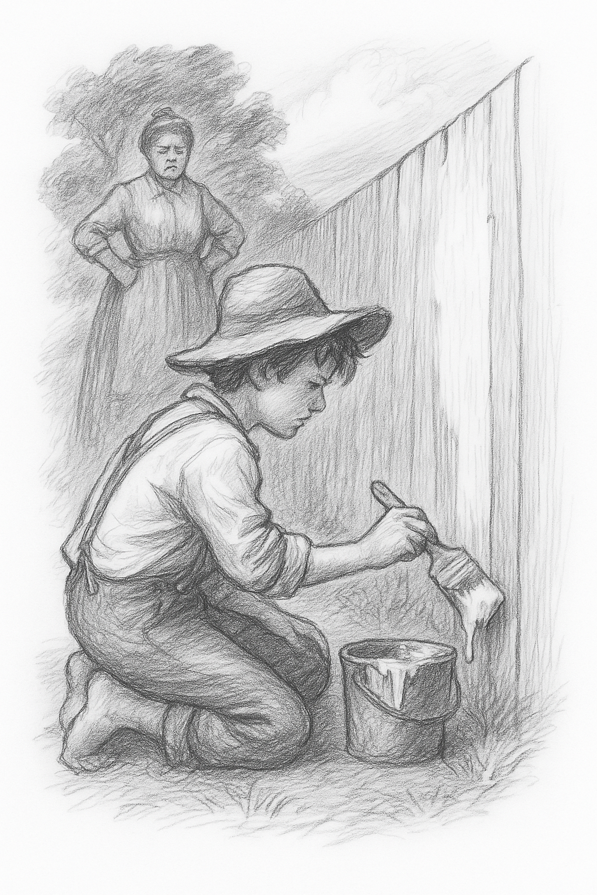

Teaching
The Adventures of Tom Sawyer
Themes
Characters
Context
Narrative
Moral Development

Slide 2
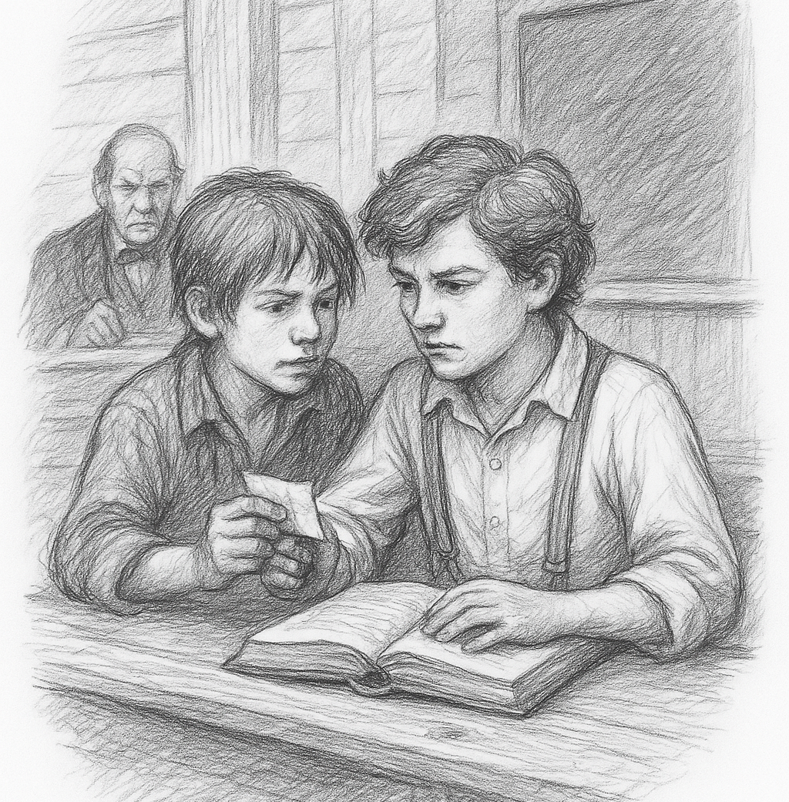
Why Teach This Novel?
Classic coming‑of‑age story
Humor and satire
Teaches moral growth
Great for
character studies

Slide 3
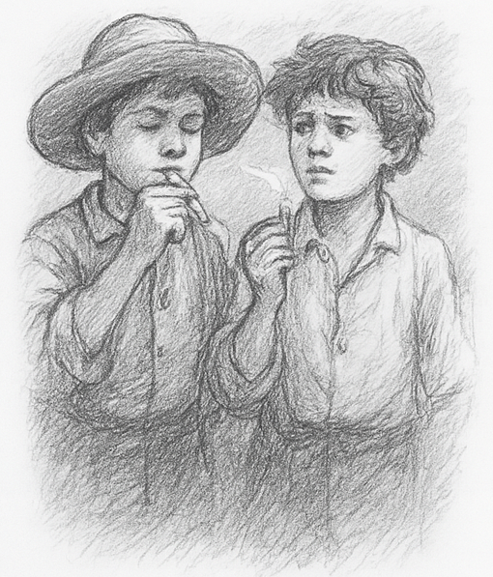
Historical Context
1840s Missouri
Small‑town life
Childhood
freedom
vs.
adult expectations

Slide 4
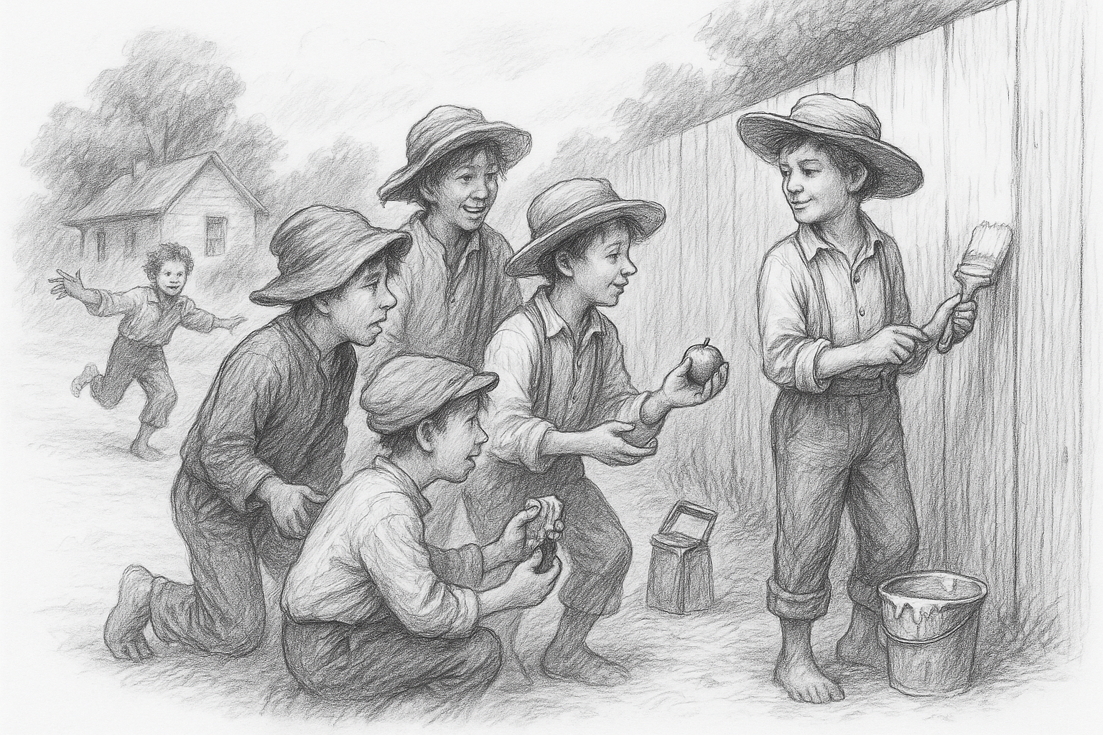
Tom Sawyer
Mischievous
Imaginative
Craves
attention
Learns
courage

Slide 5
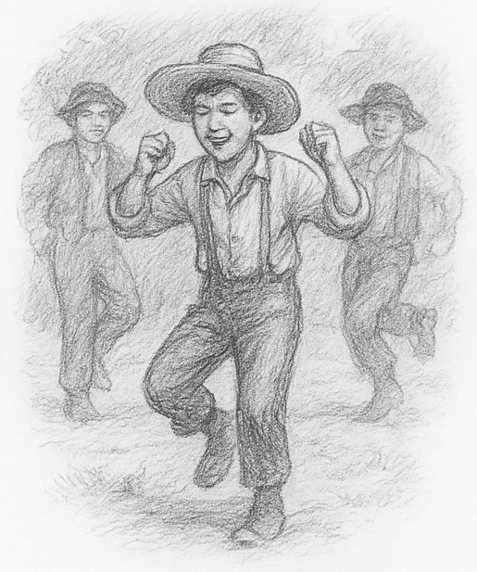
Huck Finn
Tom’s friend
Free‑spirited outsider
Contrast to
Tom’s imagination

Slide 6
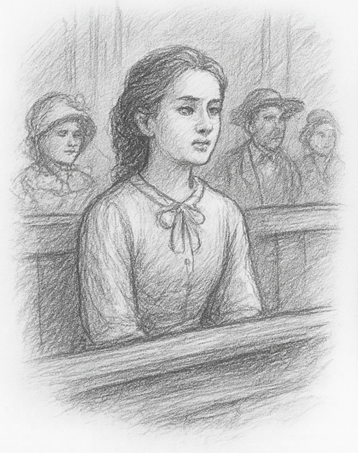
Becky Thatcher
New girl in town
Intelligent and brave
Tom’s love interest

Slide 7
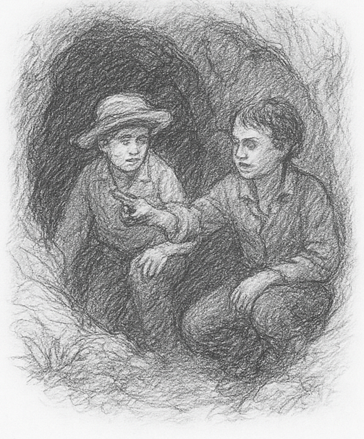
Major Plot Points
Fence‑painting trick
Graveyard scene
Pirate adventure
Trial of Muff Potter
Cave rescue

Slide 8
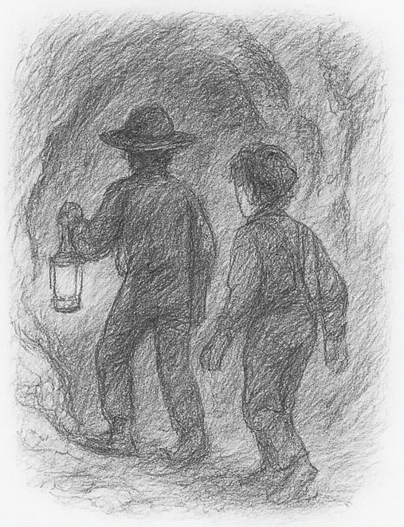
Themes
Growing up
Friendship
Imagination
Justice and courage

Slide 9
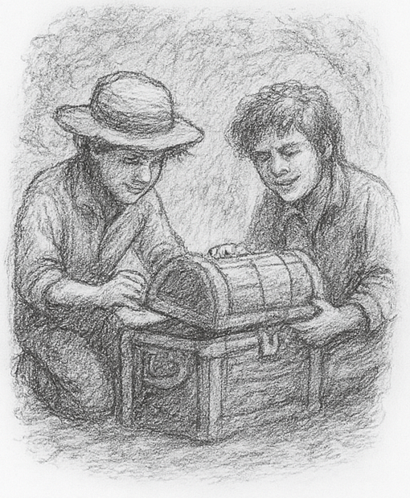
Symbolism
The cave
The town
Treasures and superstition

Slide 10
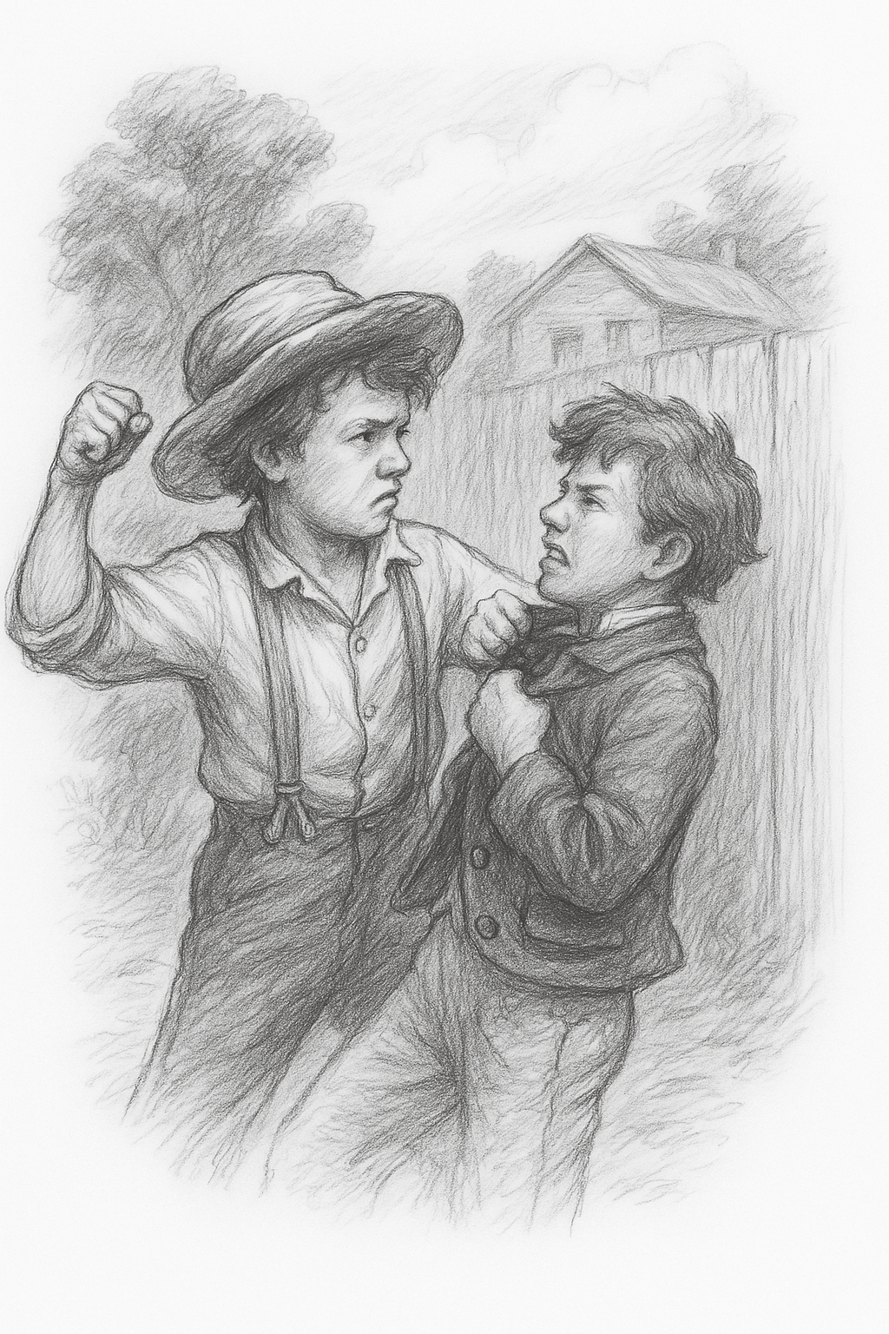
End of Deck
Teaching Tom Sawyer
helps students
explore identity,
morality, and
imagination.

